Slide 1
Visual Attributes & GANs
Noor Bafageeh

Slide 2
Outline
Attributes
How GANs Relate to Visual Attributes?
Image to image translation
Image Style Transfer Using Convolutional Neural Networks
Unpaired Image-to-Image Translation using Cycle-Consistent Adversarial Networks
What are some possible applications for GANs?

Slide 3
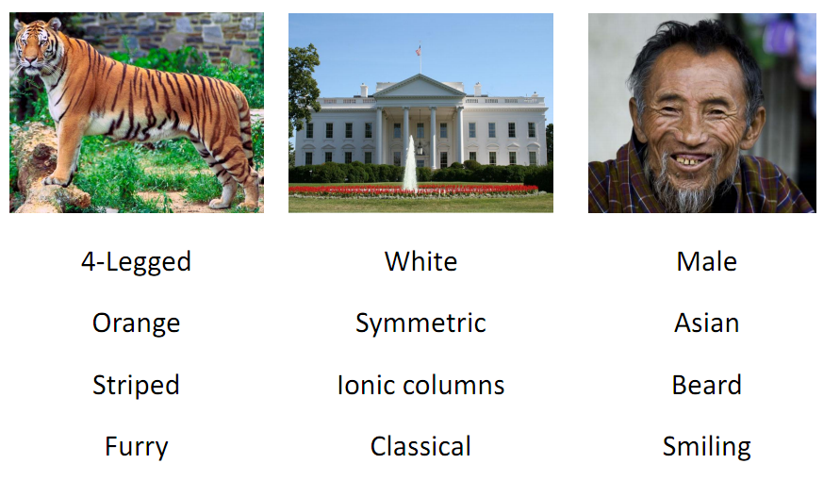
What is visual attributes?
Attributes are properties observable in images that have human-designated names, such as ‘Orange’, ‘striped’, or ‘Furry’.

Slide 4
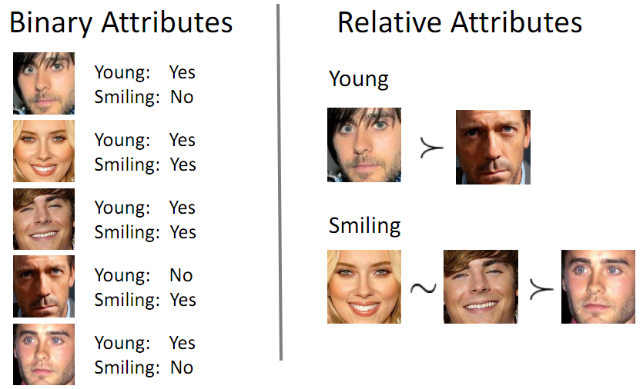

Slide 5
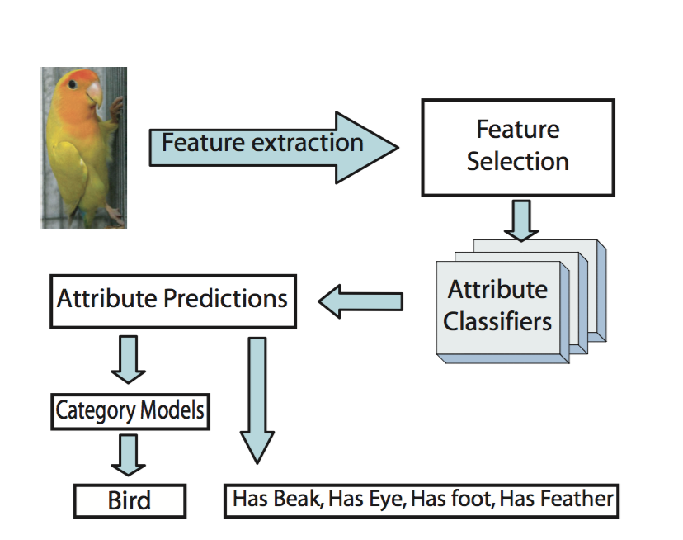
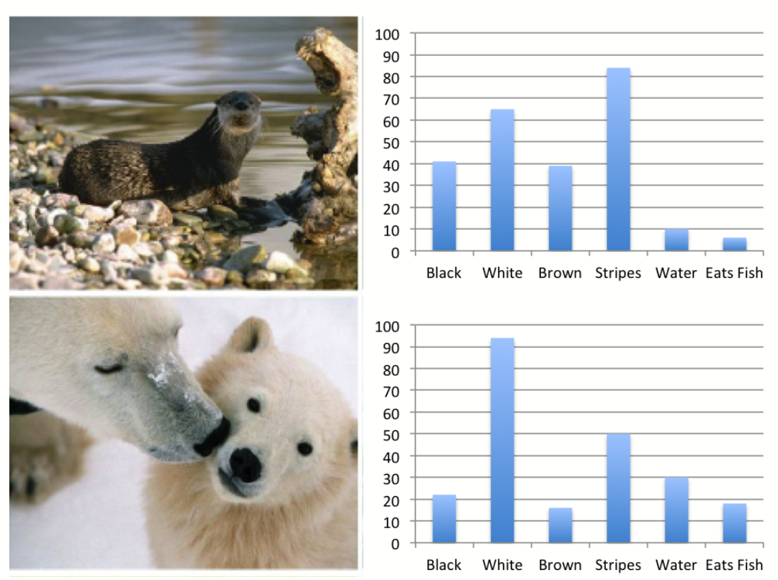
Applications
Attribute based classification
Visual Search
Zero shot learning

Slide 6
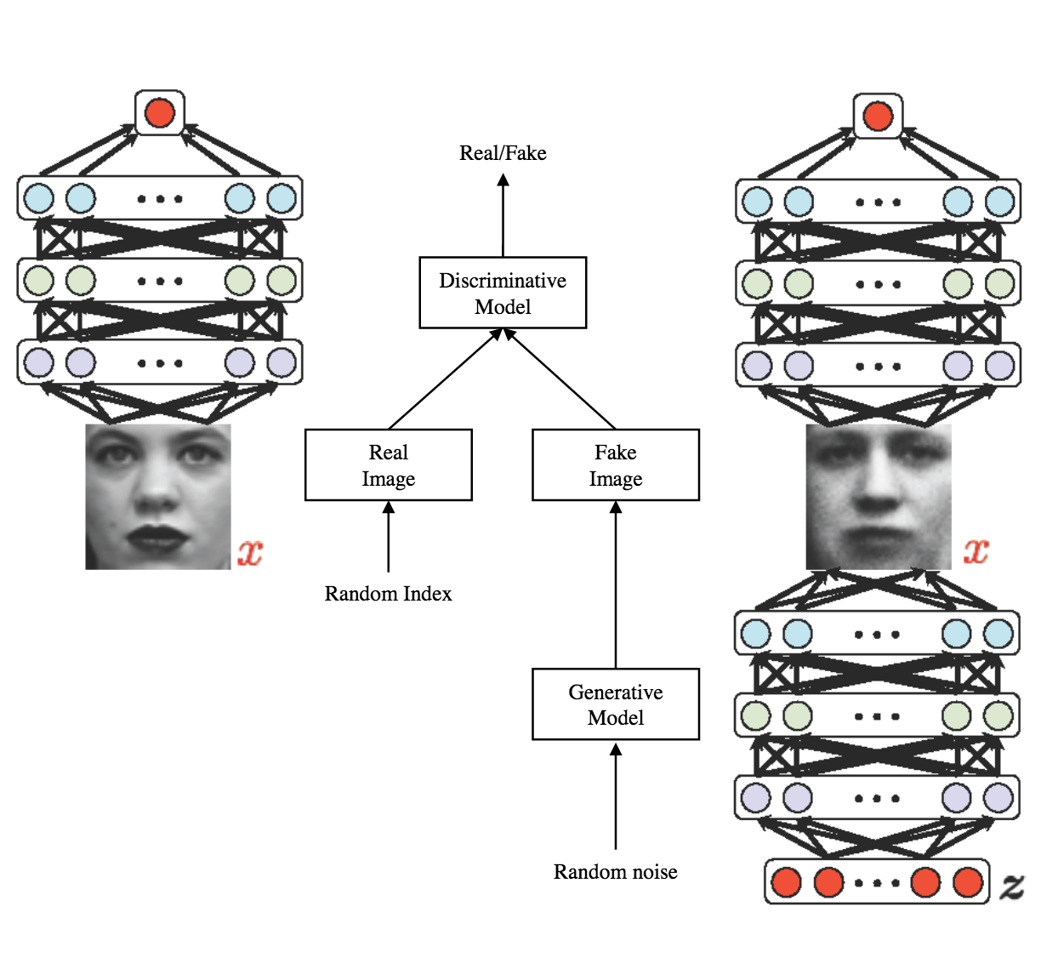
GANs
A game between:
Discriminative model D
Generative model G
G is trained to minimize the probability of its generated data being classified as fake
D is trying to maximize the probability of correctly distinguishing between fake/real data

Slide 7
How GANs Relate to Visual Attributes?
Think about GANs as a transfer of visual attributes !
Take one attribute, train only on that (i.e: Furry)
If True: it means that GANs is focusing on the attributes that are discriminative and using them to transfer over
Training Data
Attributes
Generated Image

Slide 8
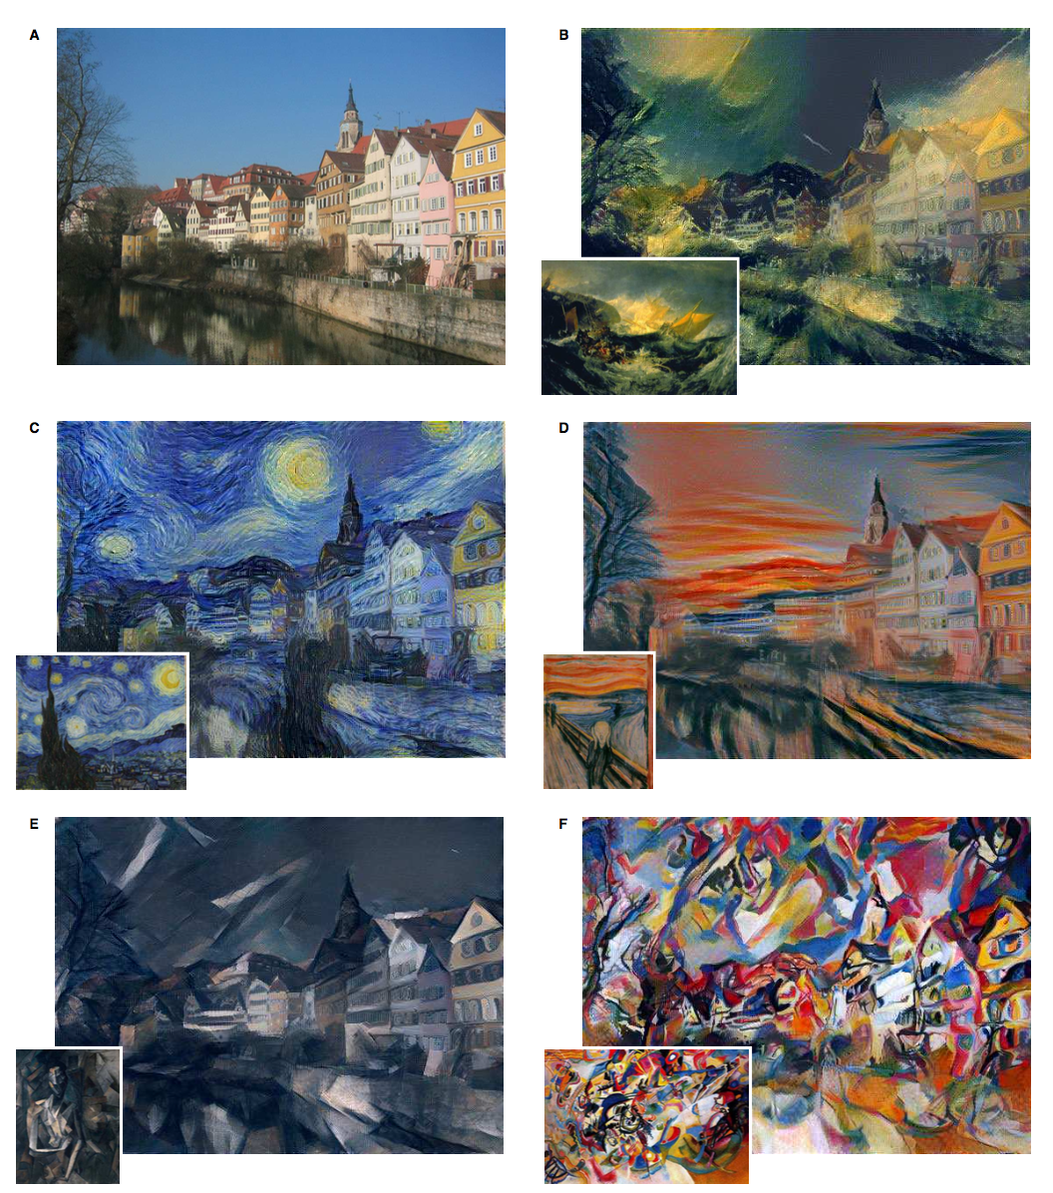
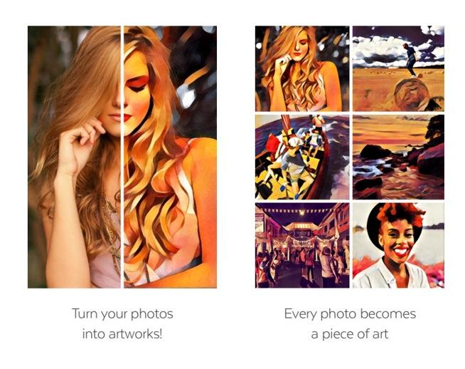

Image Style Transfer Using Convolutional Neural Networks
Rendering the semantic content of an image in different styles
[Gatys et al., University of Tubingen 2016 ]

Slide 9
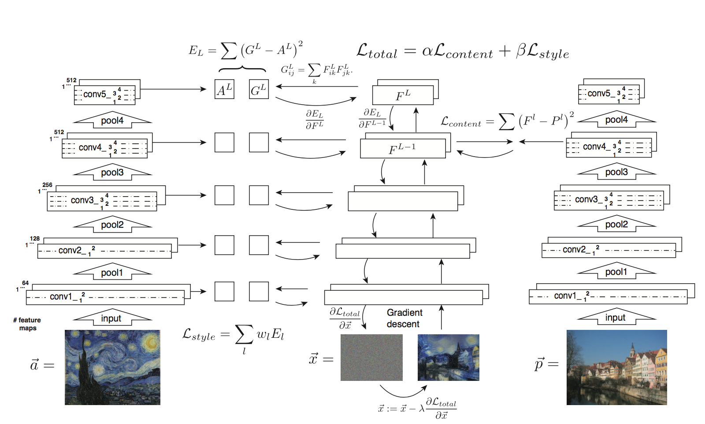

Slide 10
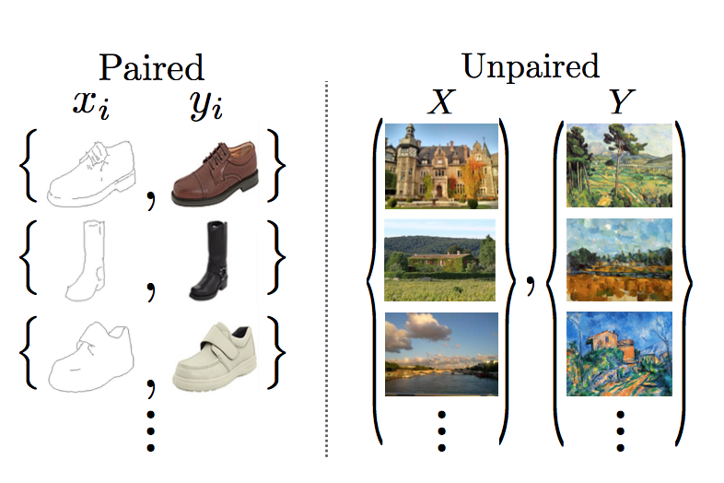
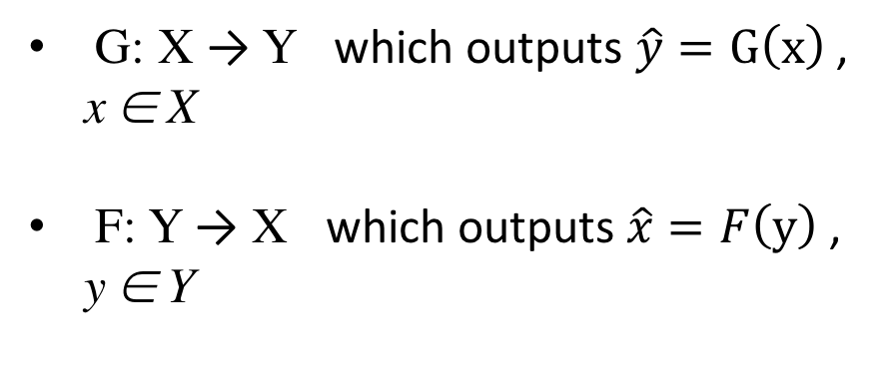
Unpaired Image-to-Image Translation using Cycle-Consistent Adversarial Networks
The goal is to learn the mapping between an input image and an output image in the absence of paired examples.
Mapping between two domains, rather than between two specific images
G: X → Y which outputs $\hat{y}=G\left(x\right)$ , x ∈ X
F: Y → X which outputs $\hat{x}=F\left(y\right)$ , y ∈ Y
[ Zhu et al., UC Berkeley 2017 ]

Slide 11
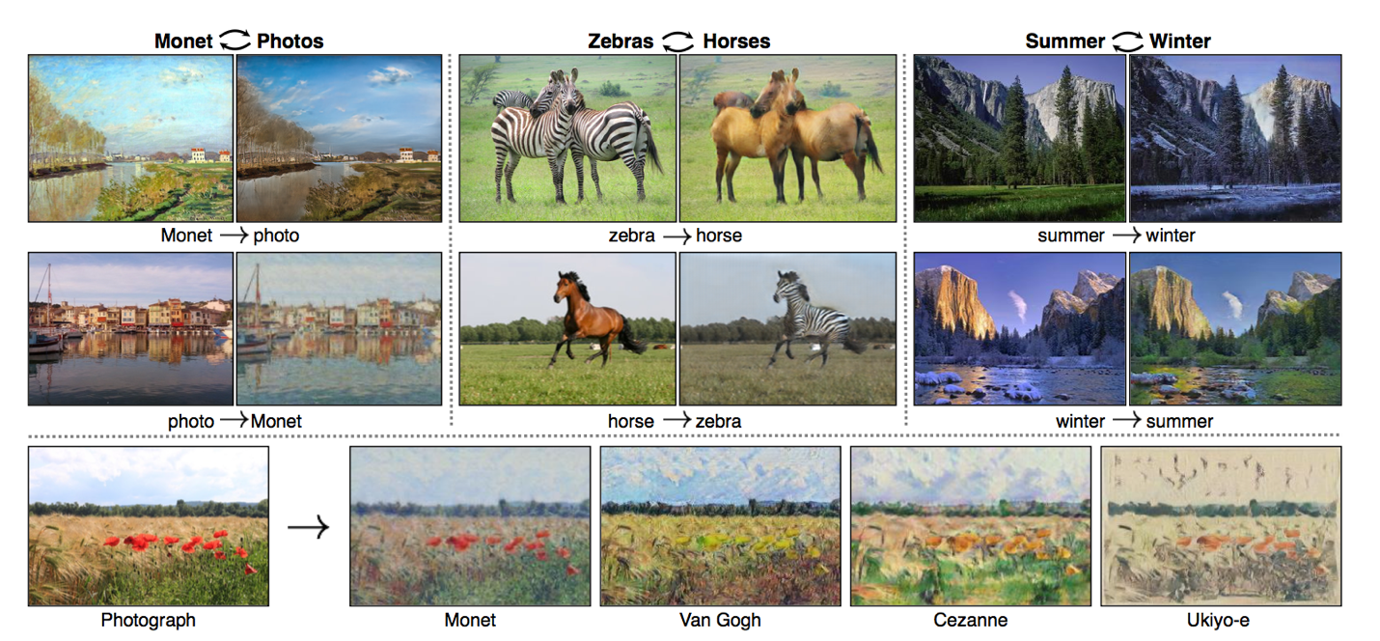
Cont.
[ Zhu et al., UC Berkeley 2017 ]

Slide 12
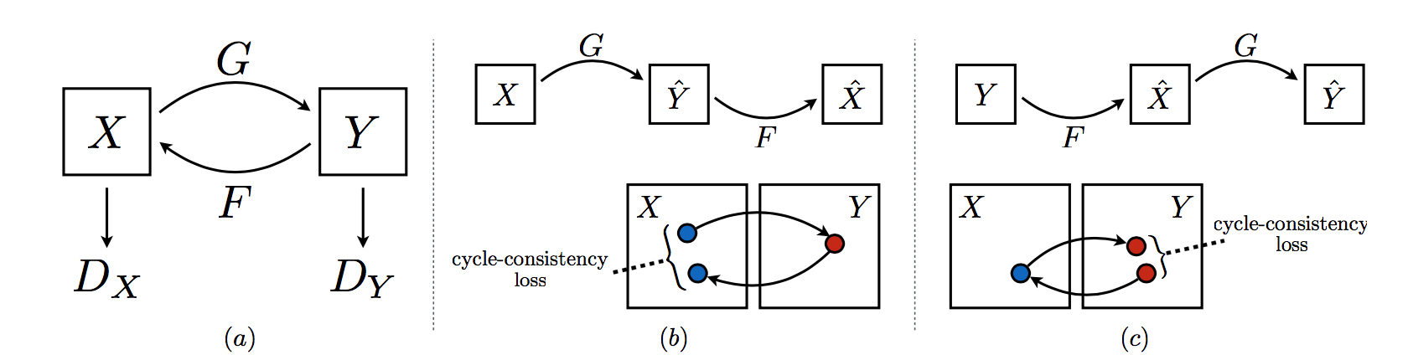
Cont.
Cycle consistency loss:
(b) forward cycle-consistency loss: x → G(x) → F(G(x)) ≈ x
(c) backward cycle-consistency loss: y → F (y) → G(F(y)) ≈ y
[ Zhu et al., UC Berkeley 2017 ]

Slide 13
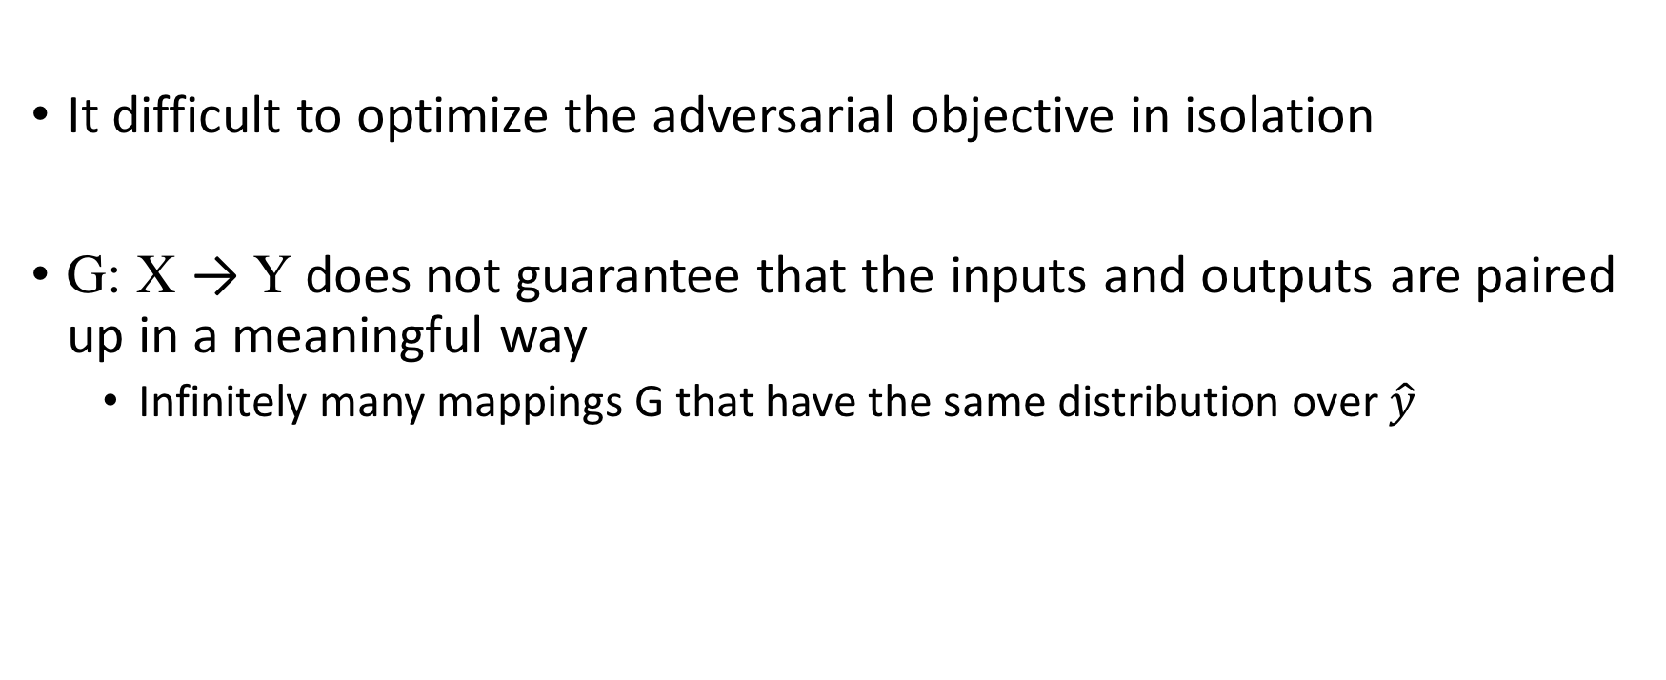
Why Cycle consistency loss?
It difficult to optimize the adversarial objective in isolation
G: X → Y does not guarantee that the inputs and outputs are paired up in a meaningful way
Infinitely many mappings G that have the same distribution over$\hat{y}$
[ Zhu et al., UC Berkeley 2017 ]

Slide 14
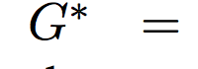
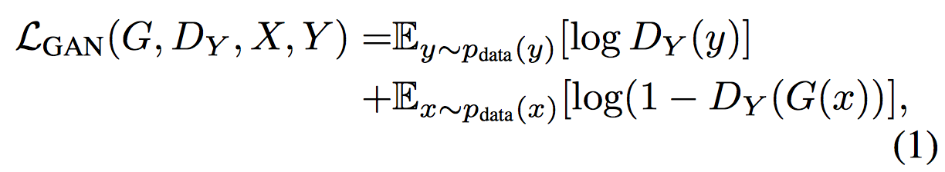
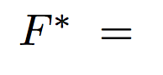
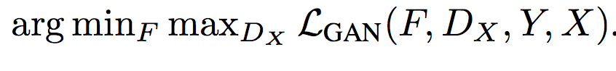
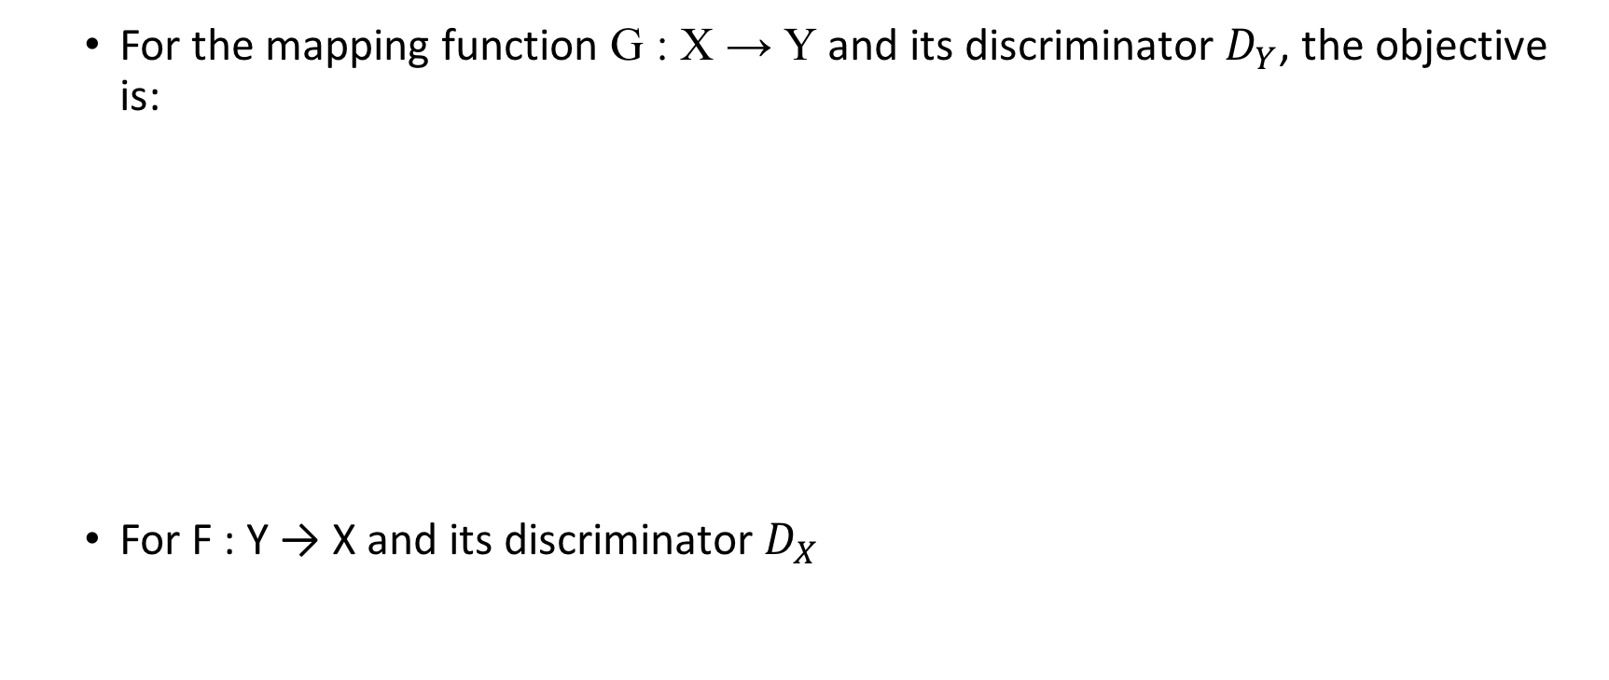
Adversarial Loss:
For the mapping function G : X → Y and its discriminator $D_{Y}$, the objective is:
For F : Y → X and its discriminator $D_{X}$
[ Zhu et al., UC Berkeley 2017 ]

Slide 15
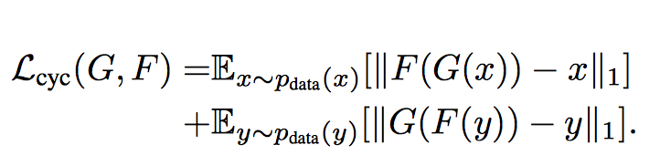
Cycle Consistency Loss:
[ Zhu et al., UC Berkeley 2017 ]

Slide 16
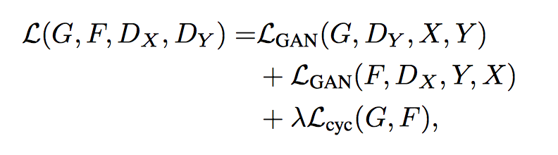
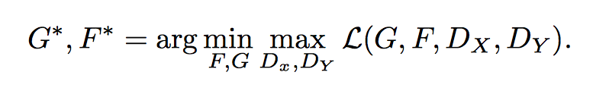
By combining the 2 losses, the full objective is :
Aim to solve:
[ Zhu et al., UC Berkeley 2017 ]

Slide 17
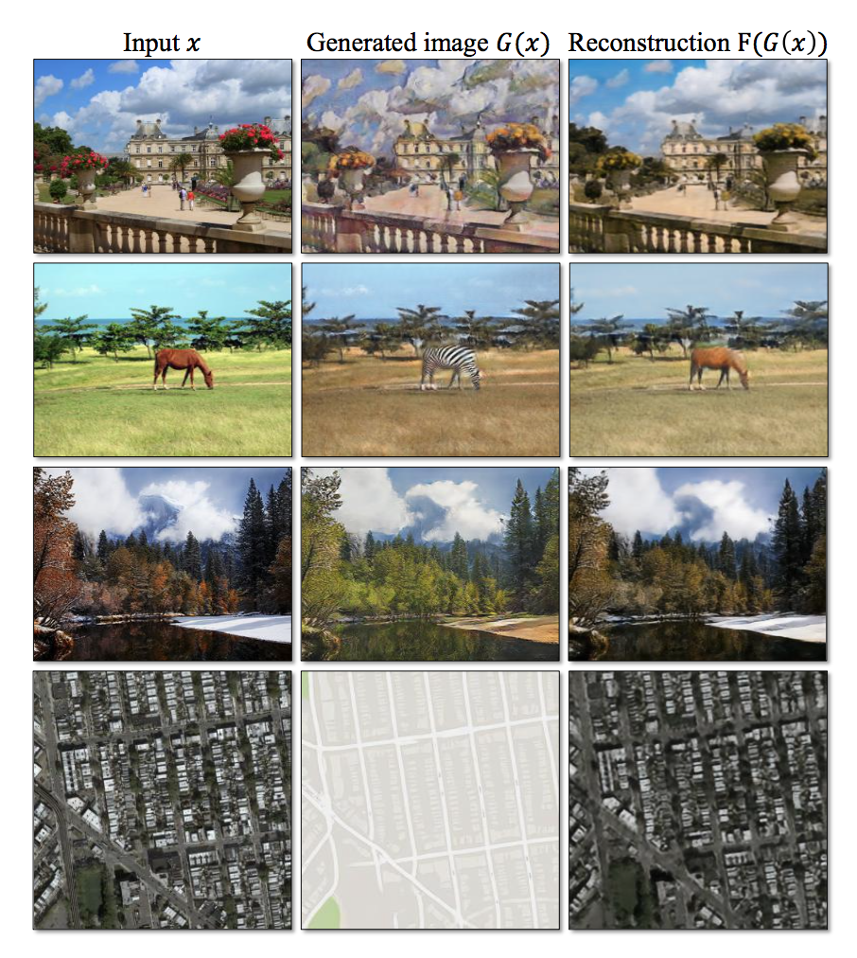
Results
[ Zhu et al., UC Berkeley 2017 ]

Slide 18
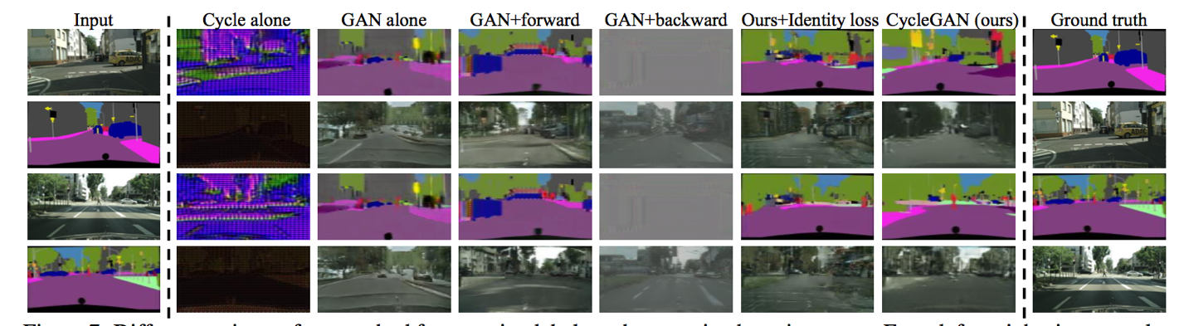
[ Zhu et al., UC Berkeley 2017 ]

Slide 19
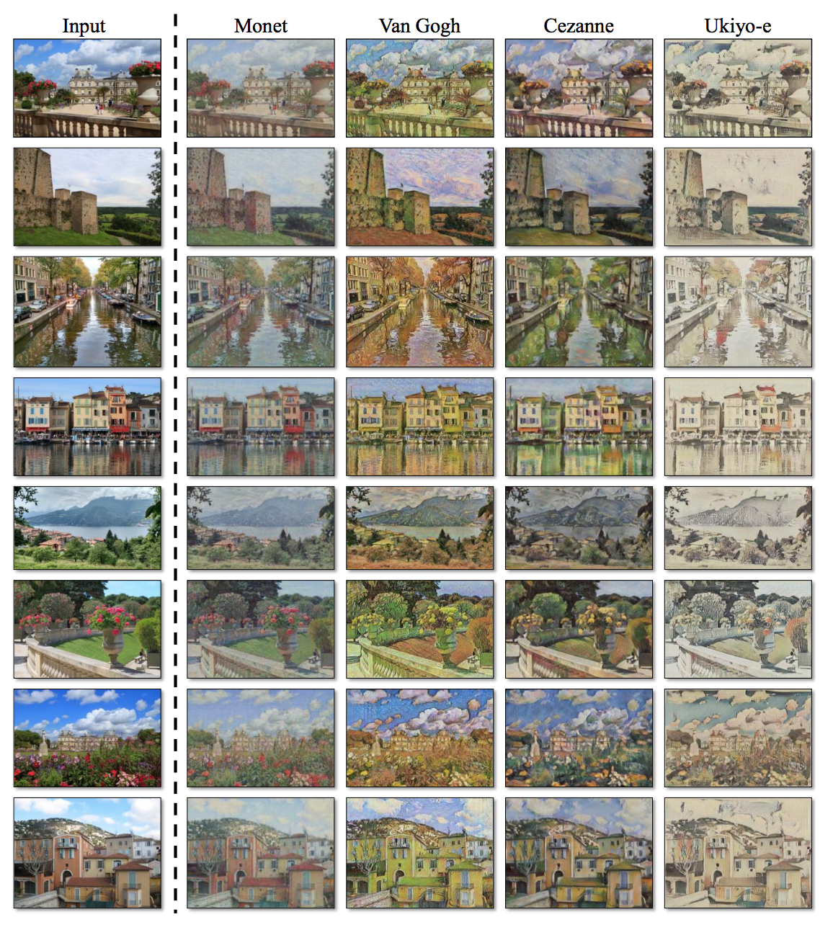
Applications to several translation problems
Style Transfer
[ Zhu et al., UC Berkeley 2017 ]

Slide 20
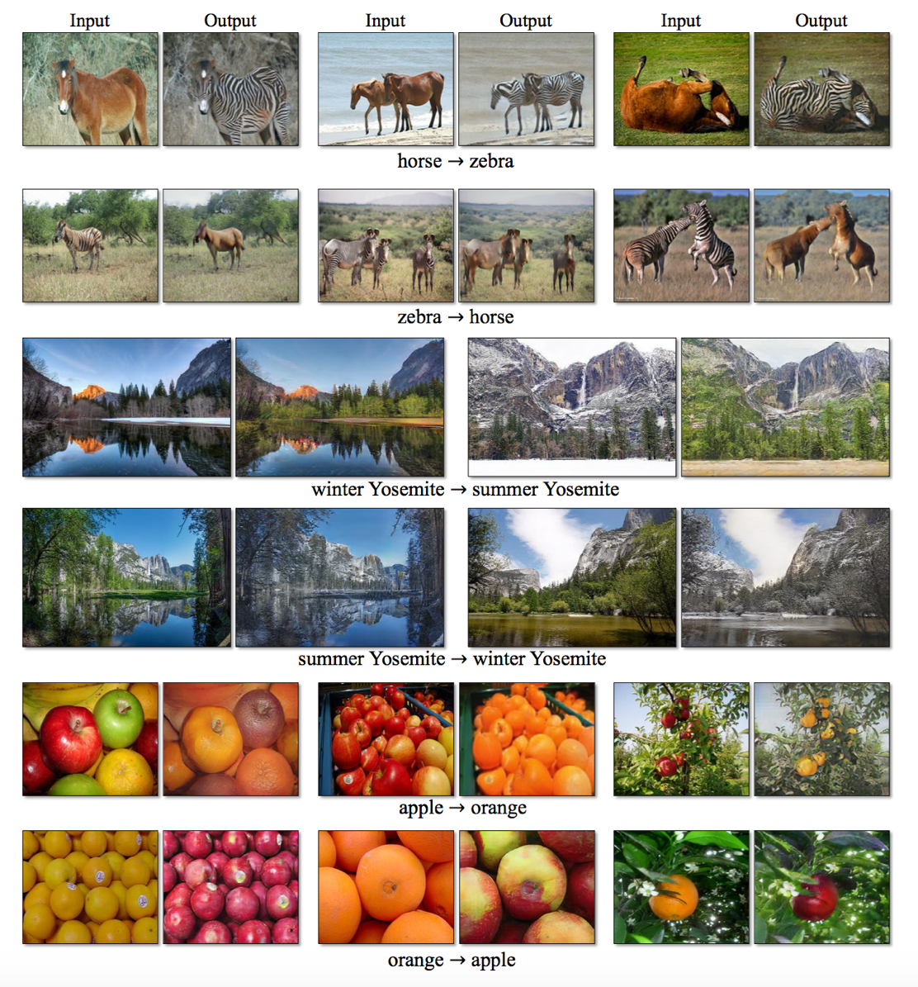
Cont.
Object transfiguration
Season Transfer
[ Zhu et al., UC Berkeley 2017 ]

Slide 21
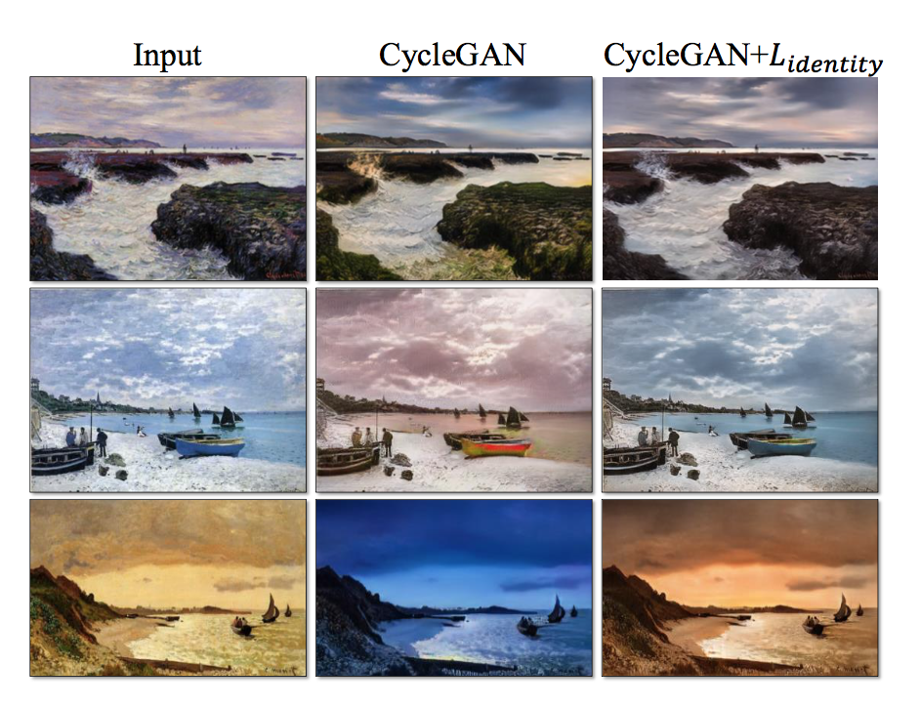

Cont.
Photo generation from paintings
Additional loss to regularize the generator to be near an identity mapping
[ Zhu et al., UC Berkeley 2017 ]

Slide 22
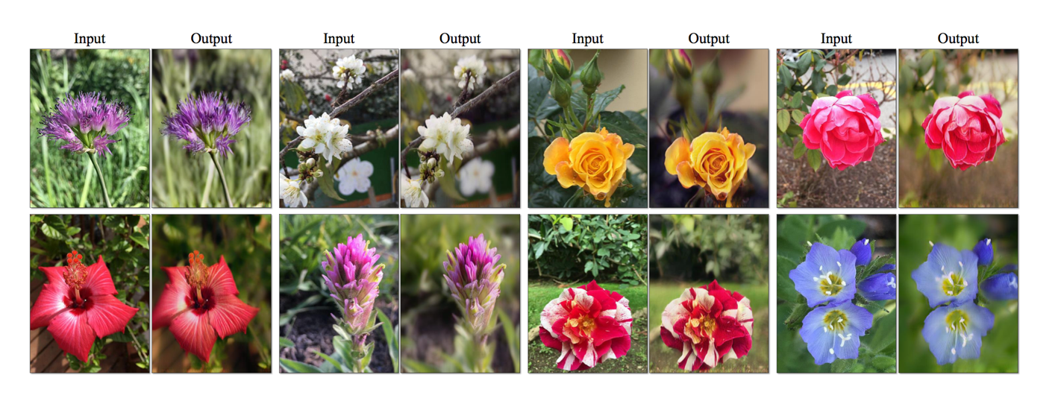
Cont.
Photo Enhancement
iPhone photos → DSLR photos: generating photos with shallower depth of field
[ Zhu et al., UC Berkeley 2017 ]

Slide 23
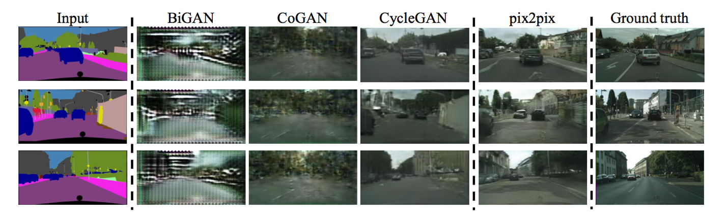
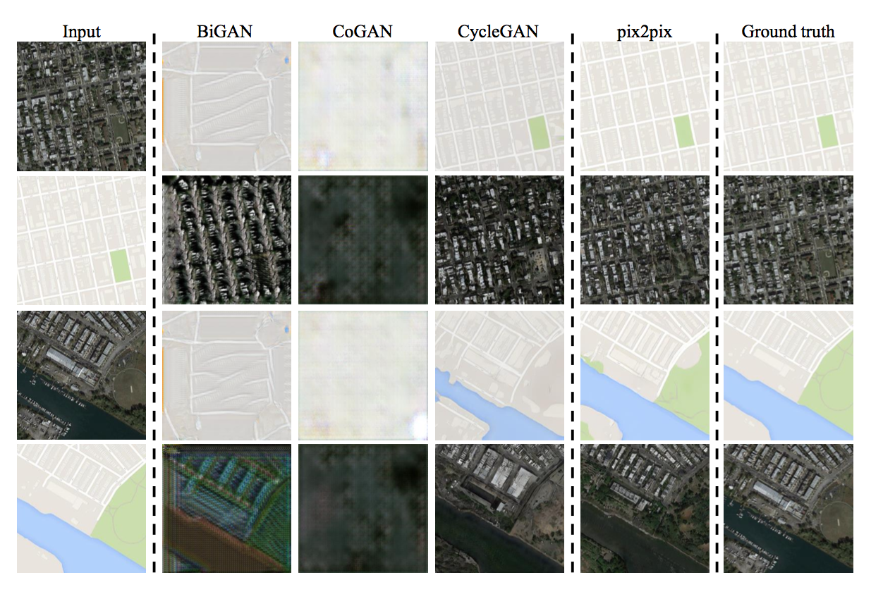

Slide 24
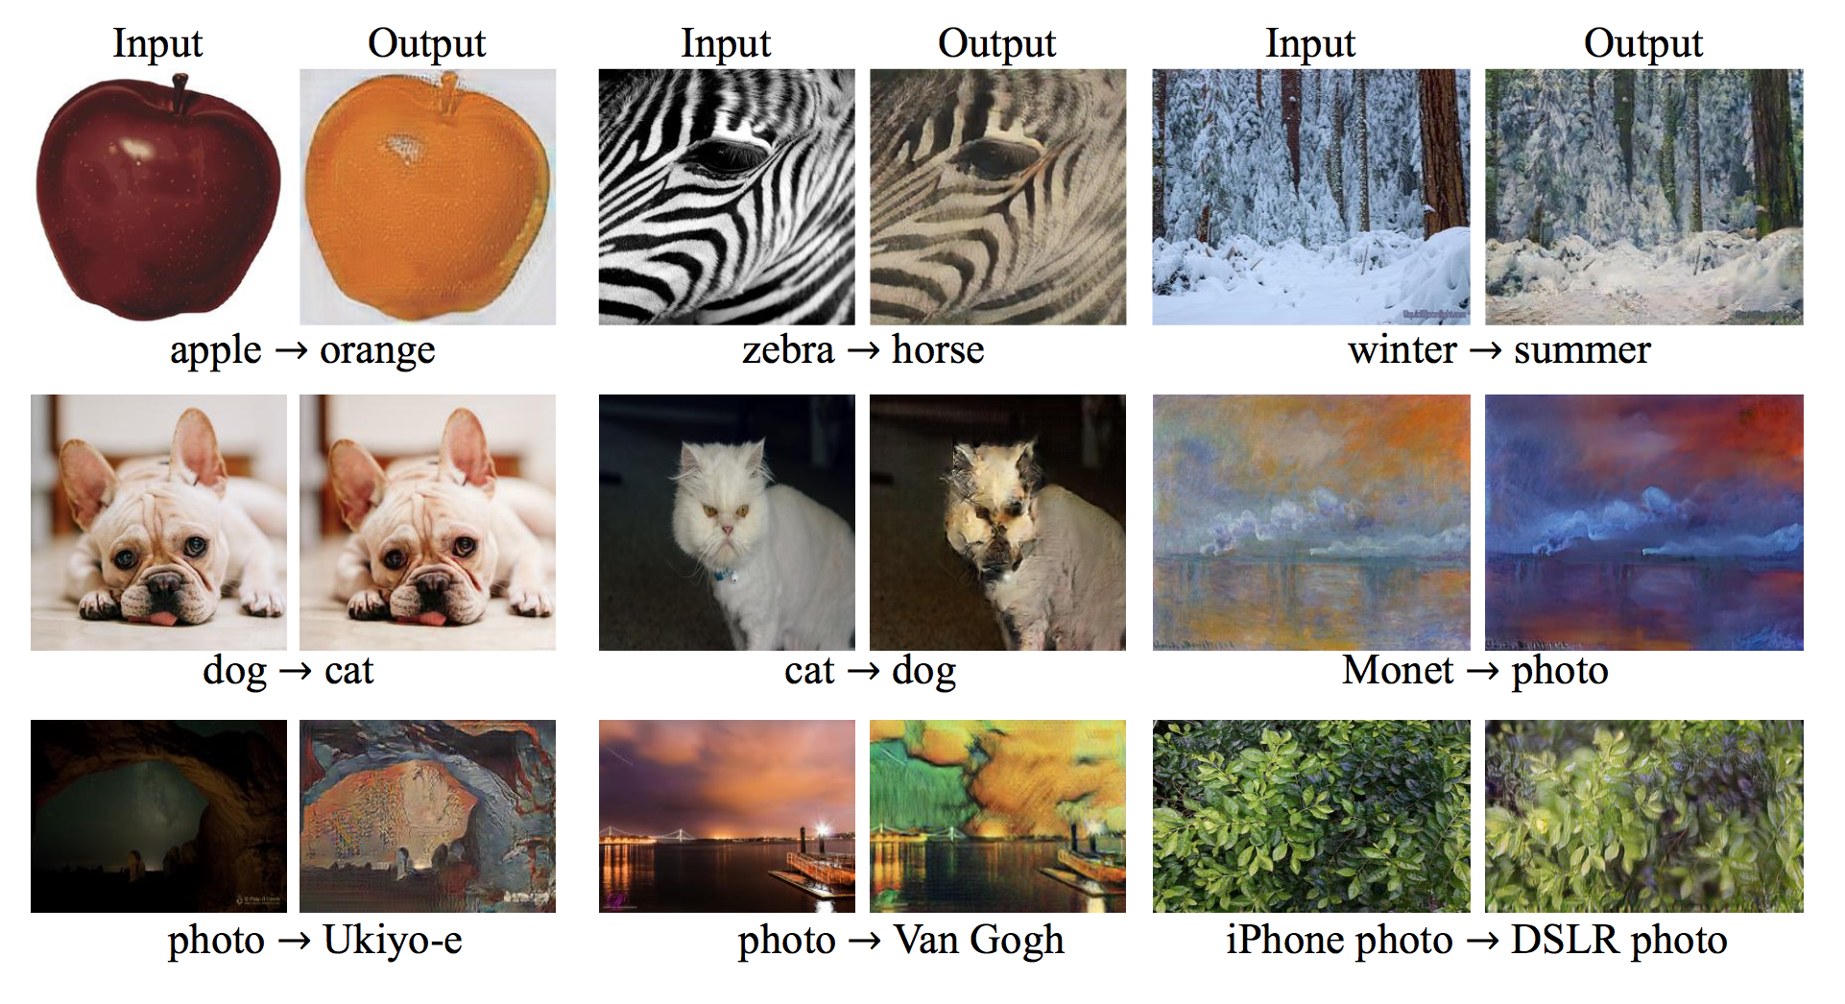
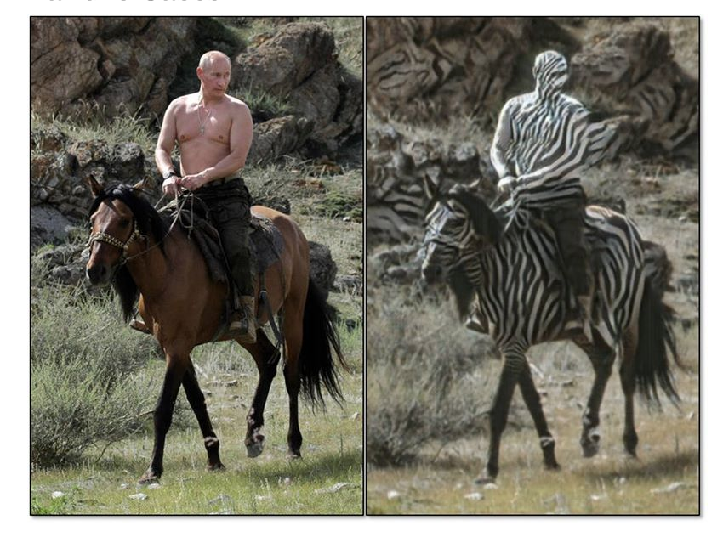
Limitations
The method often succeeds on translation tasks that involve color and texture changes
Unlike the tasks that require geometric changes
[ Zhu et al., UC Berkeley 2017 ]

Slide 25
What are some possible applications for GANs?
Applying such translations on videos
Animation
Generating images for zero/one shot learning
Simulations
Using GANs to generate high quality simulated data

Slide 26
References
L. A. Gatys, A. S. Ecker and M. Bethge, "Image Style Transfer Using Convolutional Neural Networks," 2016 IEEE Conference on Computer Vision and Pattern Recognition (CVPR), Las Vegas, NV, 2016, pp. 2414-2423.
Jun-Yan Zhu*, Taesung Park*, Phillip Isola, and Alexei A. Efros. "Unpaired Image-to-Image Translation using Cycle-Consistent Adversarial Networks", in arxiv, 2017.
Goodfellow, I., Pouget-Abadie, J., Mirza, M., Xu, B., Warde-Farley, D., Ozair, S., Courville, A., & Bengio, Y. (2014). Generative Adversarial Nets. In Advances in neural information processing systems (pp. 2672-2680).
Goodfellow, I. (2016). NIPS 2016 Tutorial: Generative Adversarial Networks. arXiv preprint.
https://junyanz.github.io/CycleGAN/

Slide 27
Thank You ☺

